Slide 1

Chapter 19
Network Layer:
Logical Addressing
19.‹#›
Copyright © The McGraw-Hill Companies, Inc. Permission required for reproduction or display.
Notes:
‹#›

Slide 2
19-1 IPv4 ADDRESSES
An IPv4 address is a 32-bit address that uniquely and universally defines the connection of a device (for example, a computer or a router) to the Internet.
The address space of IPv4 is 2³² or 4,294,967,296.
Topics discussed in this section:
Address Space Notations
Classful Addressing
Classless Addressing
Network Address Translation (NAT)
19.‹#›
Notes:
‹#›

Slide 3
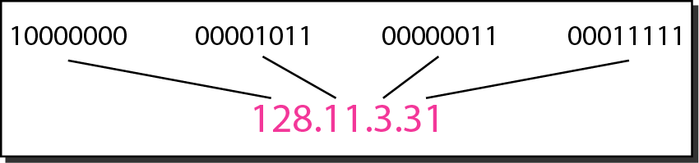
Figure 19.1 Dotted-decimal notation and binary notation for an IPv4 address
19.‹#›
Notes:
‹#›

Slide 4
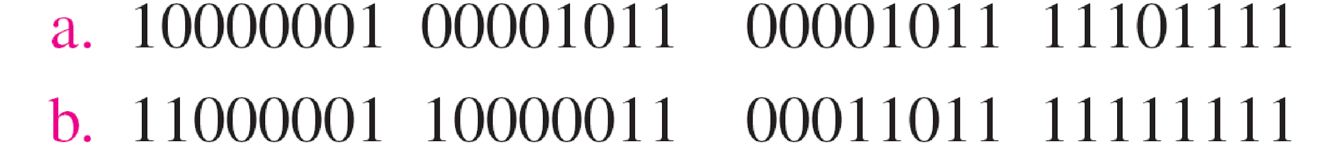
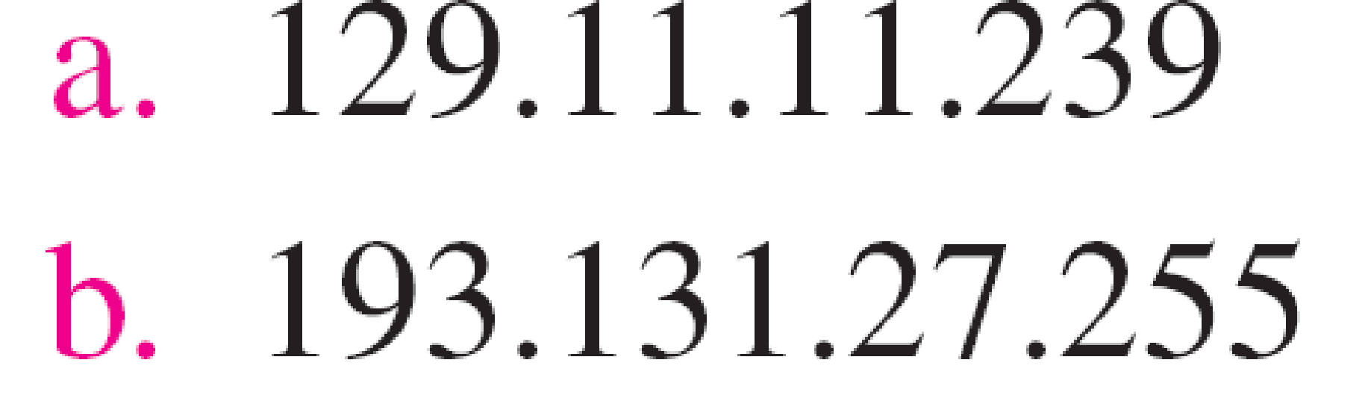
Example 19.1
Change the following IPv4 addresses from binary notation to dotted-decimal notation.
Solution
We replace each group of 8 bits with its equivalent decimal number (see Appendix B) and add dots for separation.
19.‹#›
Notes:
‹#›

Slide 5
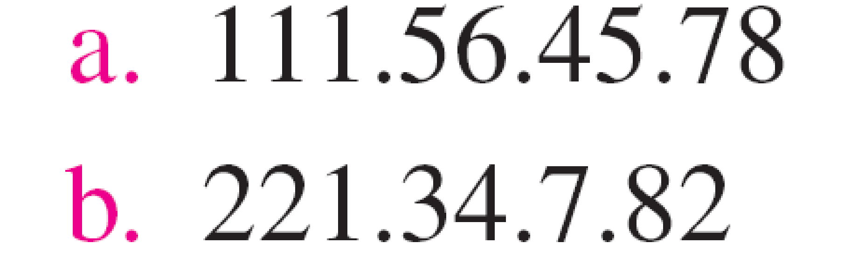
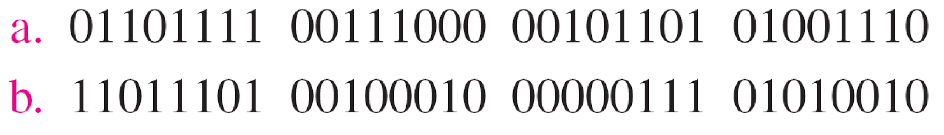
Example 19.2
Change the following IPv4 addresses from dotted-decimal notation to binary notation.
Solution
We replace each decimal number with its binary equivalent (see Appendix B).
19.‹#›
Notes:
‹#›

Slide 6
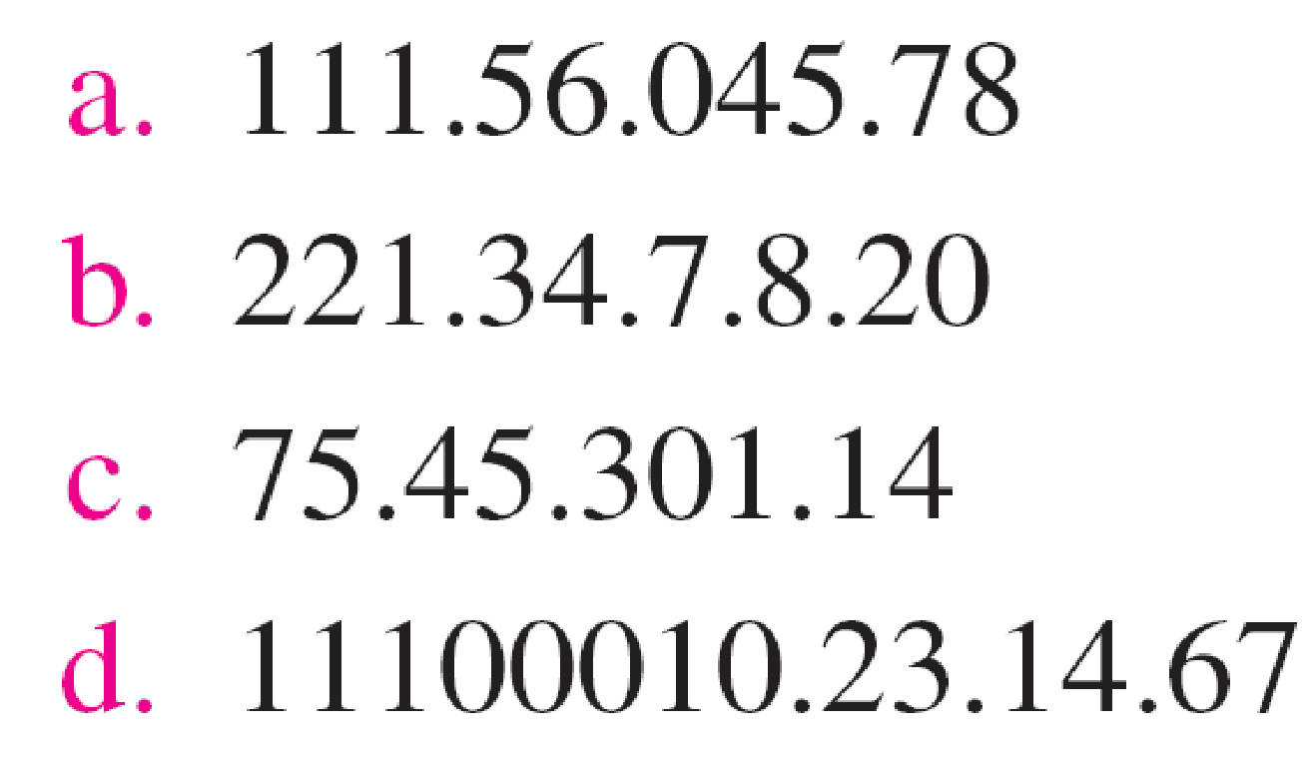
Example 19.3
Find the error, if any, in the following IPv4 addresses.
Solution
a. There must be no leading zero (045).
b. There can be no more than four numbers.
c. Each number needs to be less than or equal to 255.
d. A mixture of binary notation and dotted-decimal notation is not allowed.
19.‹#›
Notes:
‹#›

Slide 7

Note
In classful addressing, the address space is divided into five classes:
A, B, C, D, and E.
19.‹#›
Notes:
‹#›

Slide 8
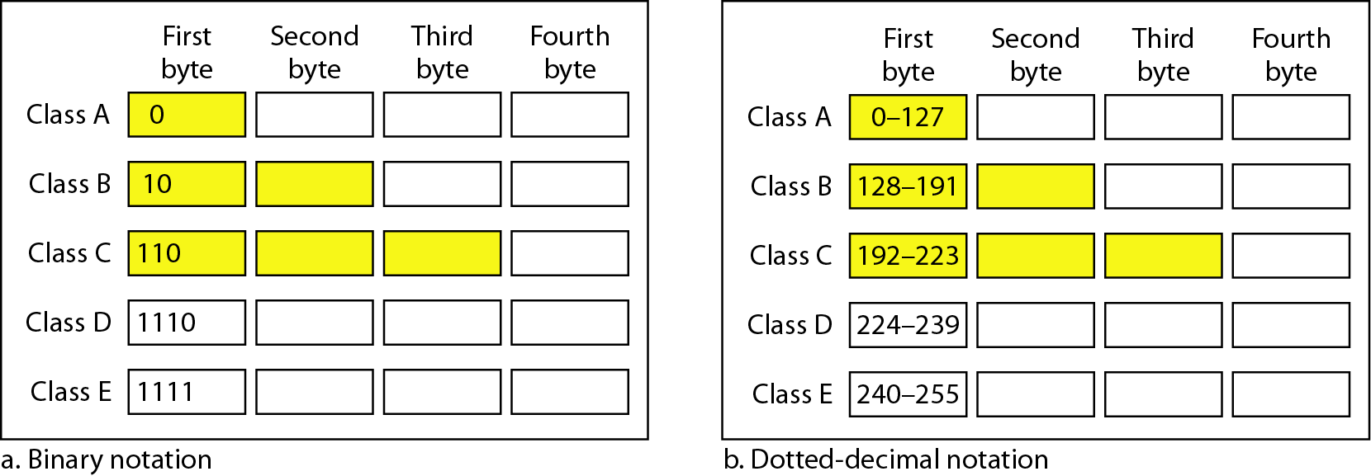
Figure 19.2 Finding the classes in binary and dotted-decimal notation
19.‹#›
Notes:
‹#›

Slide 9
Example 19.4
Find the class of each address.
a. 00000001 00001011 00001011 11101111
b. 11000001 10000011 00011011 11111111
c. 14.23.120.8
d. 252.5.15.111
Solution
a. The first bit is 0. This is a class A address.
b. The first 2 bits are 1; the third bit is 0. This is a class C address.
c. The first byte is 14; the class is A.
d. The first byte is 252; the class is E.
19.‹#›
Notes:
‹#›

Slide 10
Note
In IPv4 addressing, a block of addresses can be defined as x.y.z.t /n
in which x.y.z.t defines one of the addresses and the /n defines the mask.
A subnet mask or mask is a number that defines a range of IP addresses available within a network.
The first address in the block can be found by setting the rightmost 32 − n bits to 0s.
The last address in the block can be found by setting the rightmost 32 − n bits to 1s.
19.‹#›
Notes:
‹#›

Slide 11
Example 19.6
A block of addresses is granted to a small organization. We know that one of the addresses is 205.16.37.39/28. What is the first address in the block?
Solution
The binary representation of the given address is
11001101 00010000 00100101 00100111
If we set 32−28 rightmost bits to 0, we get
11001101 00010000 00100101 0010000
or 205.16.37.32.
This is actually the block shown in Figure 19.3.
19.‹#›
Notes:
‹#›

Slide 12
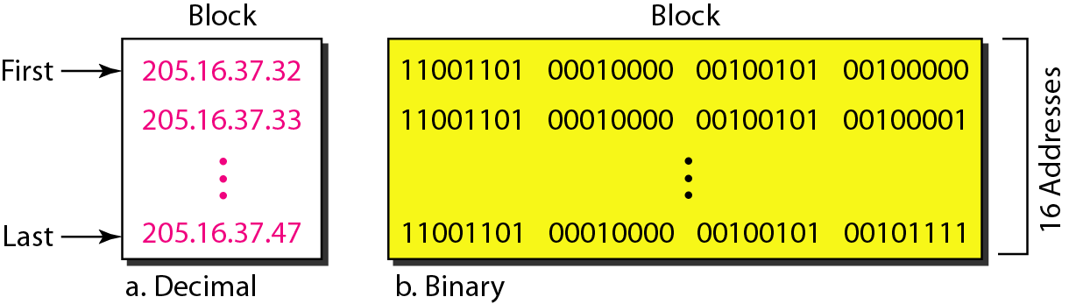
Figure 19.3 A block of 16 addresses granted to a small organization
19.‹#›
Notes:
‹#›

Slide 13
Example 19.7
Find the last address for the block in Example 19.6.
Solution
The binary representation of the given address is
11001101 00010000 00100101 00100111
If we set 32 − 28 rightmost bits to 1, we get
11001101 00010000 00100101 00101111
or
205.16.37.47
This is actually the block shown in Figure 19.3.
19.‹#›
Notes:
‹#›

Slide 14
Note
The number of addresses in the block can be found by using the formula 2^{32−n}.
19.‹#›
Notes:
‹#›

Slide 15
Example 19.8
Find the number of addresses in Example 19.6.
Solution
The value of n is 28, which means that number of addresses is 2 ³²⁻²⁸ or 16.
19.‹#›
Notes:
‹#›

Slide 16
Figure 19.4 A network configuration for the block 205.16.37.32/28
19.‹#›
Notes:
‹#›

Slide 17
Note
The first address in a block is normally not assigned to any device; it is used as the network address that represents the organization to the rest of the world.
19.‹#›
Notes:
‹#›

Slide 18
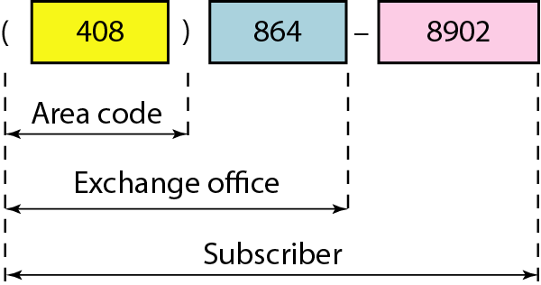
Figure 19.5 Two levels of hierarchy in an IPv4 address
19.‹#›
Notes:
‹#›

Slide 19
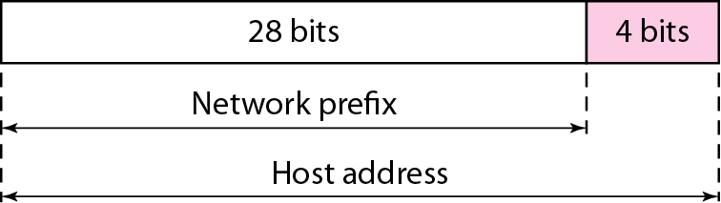
Figure 19.6 A frame in a character-oriented protocol
Each address in the block can be considered as a two-level hierarchical structure:
The leftmost n bits (prefix) define the network;
The rightmost 32 − n bits define the host.
19.‹#›
Notes:
‹#›

Slide 20
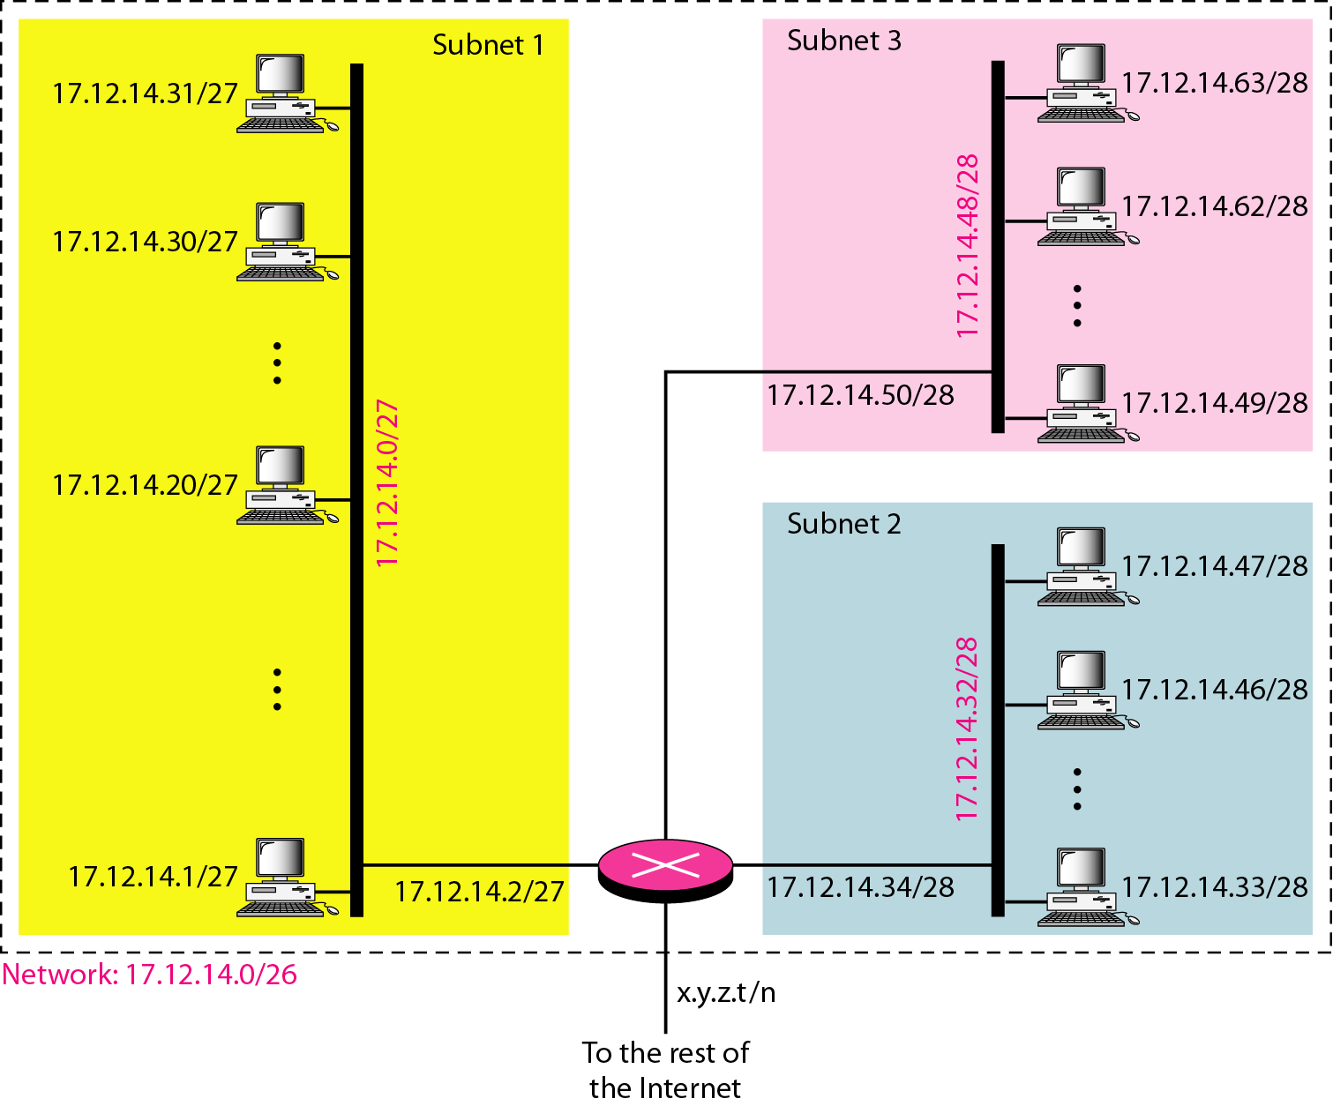
Figure 19.7 Configuration and addresses in a subnetted network
19.‹#›
Notes:
‹#›

Slide 21
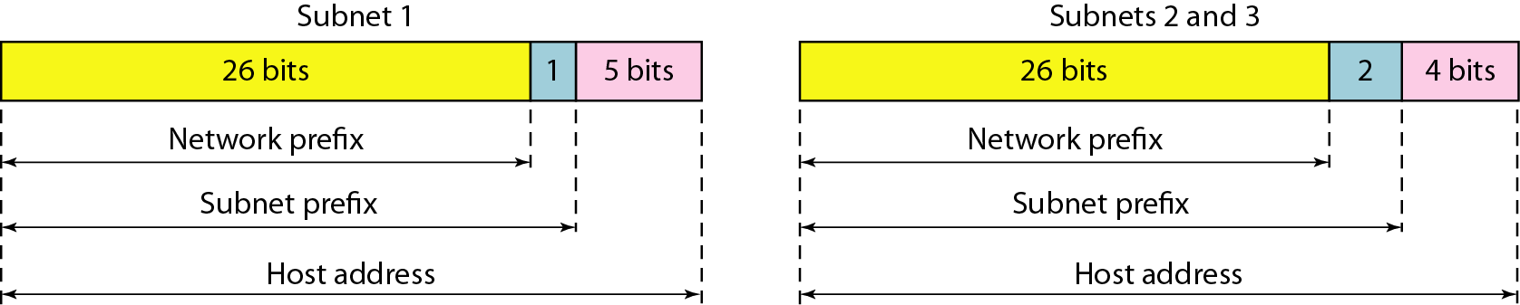
Figure 19.8 Three-level hierarchy in an IPv4 address
19.‹#›
Notes:
‹#›

Slide 22
Example 19.10
An ISP is granted a block of addresses starting with 190.100.0.0/16 (65,536 addresses). The ISP needs to distribute these addresses to three groups of customers as follows:
a. The first group has 64 customers; each needs 256 addresses.
b. The second group has 128 customers; each needs 128 addresses.
c. The third group has 128 customers; each needs 64 addresses.
Design the subblocks and find out how many addresses are still available after these allocations.
19.‹#›
Notes:
‹#›

Slide 23
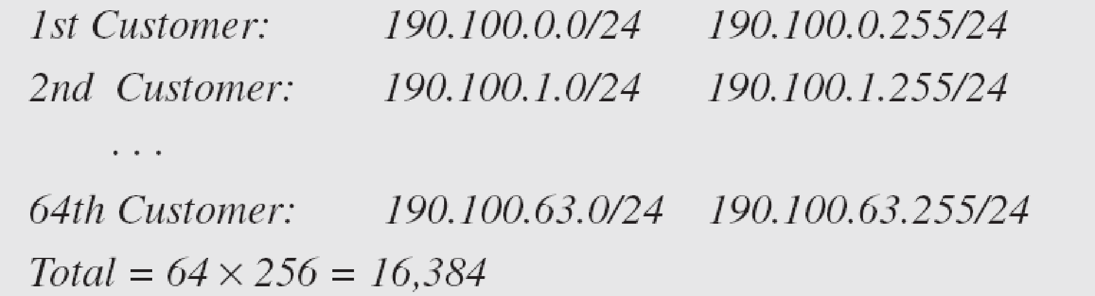
Example 19.10 (continued)
Solution
Figure 19.9 shows the situation.
Group 1
For this group, each customer needs 256 addresses. This means that 8 (log2 256) bits are needed to define each host. The prefix length is then 32 − 8 = 24. The addresses are
19.‹#›
Notes:
‹#›

Slide 24
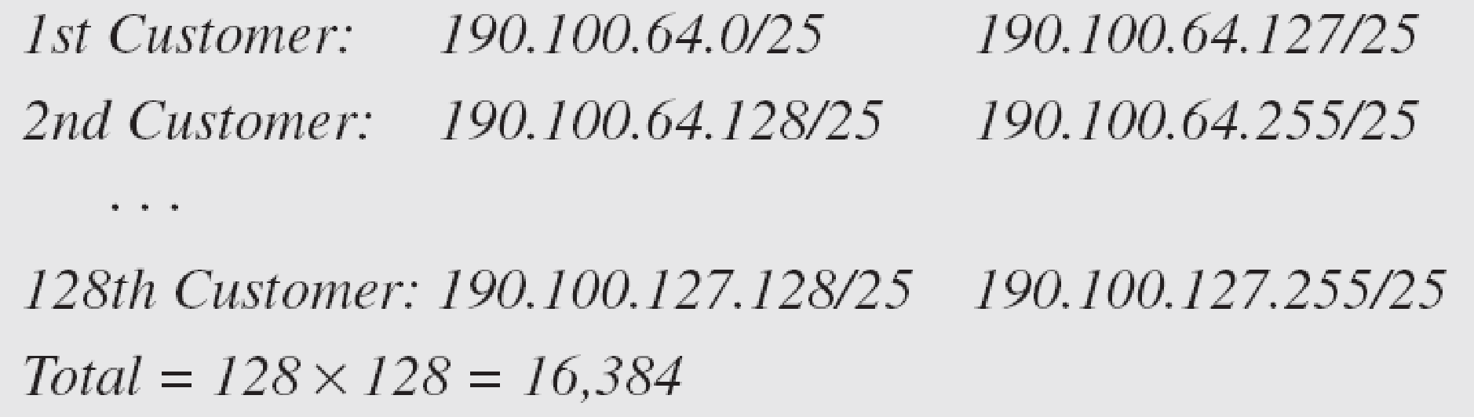
Example 19.10 (continued)
Group 2
For this group, each customer needs 128 addresses. This means that 7 (log2 128) bits are needed to define each host. The prefix length is then 32 − 7 = 25. The addresses are
19.‹#›
Notes:
‹#›

Slide 25
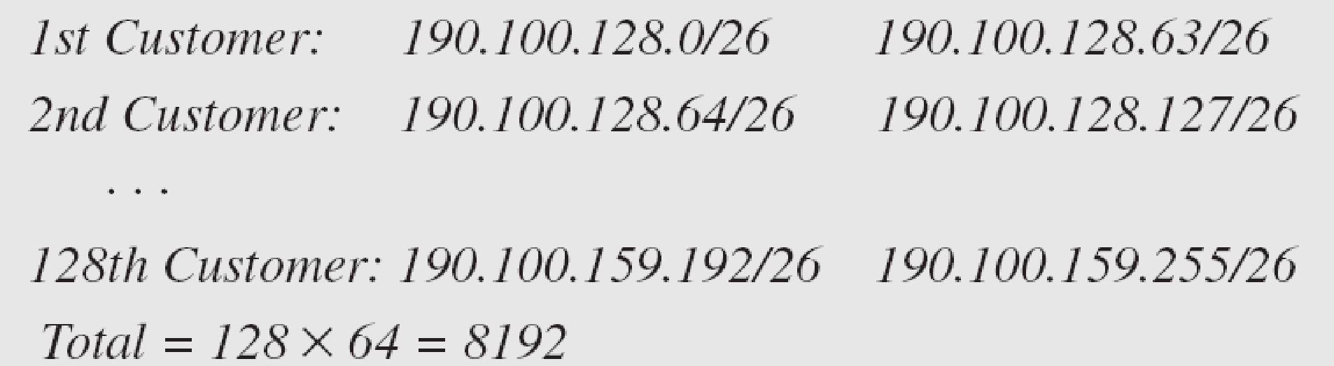
Example 19.10 (continued)
Group 3
For this group, each customer needs 64 addresses. This means that 6 (log₂64) bits are needed to each host. The prefix length is then 32 − 6 = 26. The addresses are
Number of granted addresses to the ISP: 65,536
Number of allocated addresses by the ISP: 40,960
Number of available addresses: 24,576
19.‹#›
Notes:
‹#›

Slide 26
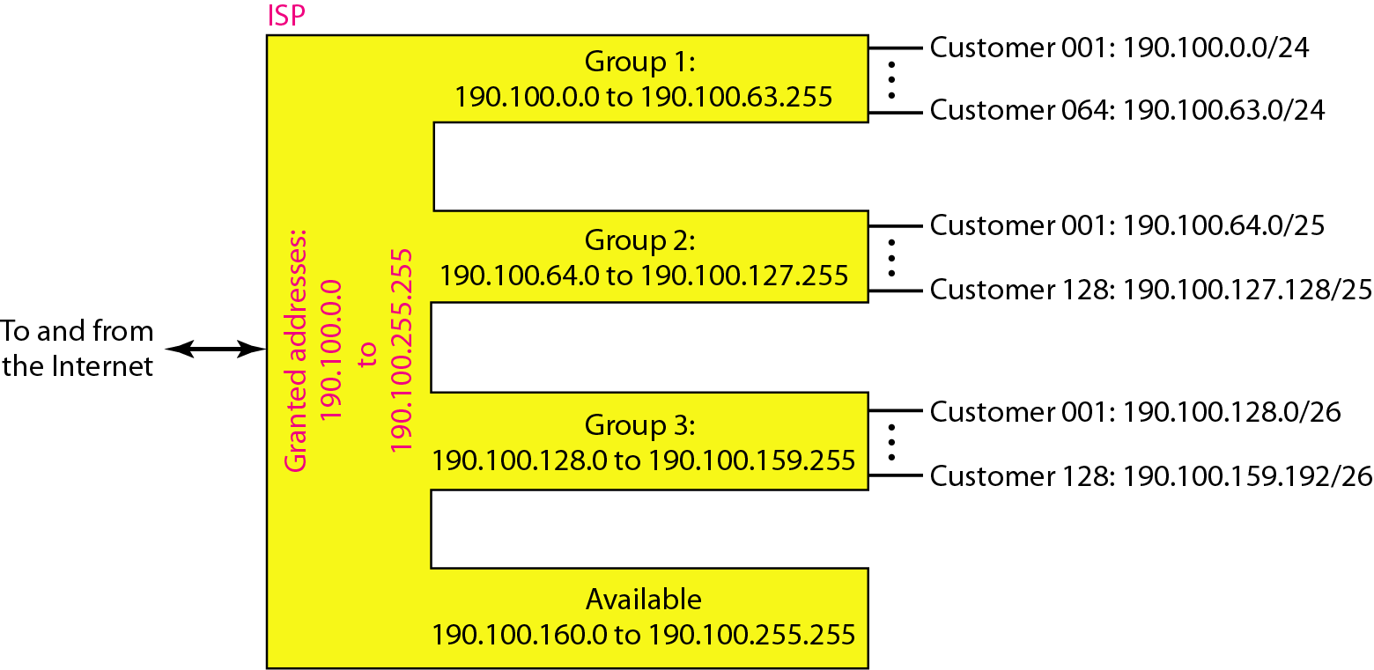
Figure 19.9 An example of address allocation and distribution by an ISP
19.‹#›
Notes:
‹#›

Slide 27
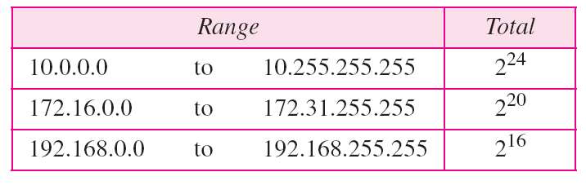
Table 19.3 Addresses for private networks
19.‹#›
Notes:
‹#›

Slide 28
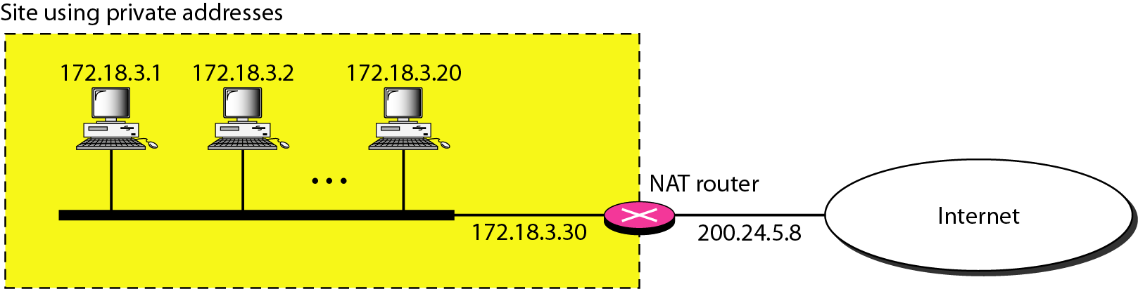
Figure 19.10 A NAT implementation
19.‹#›
Notes:
‹#›

Slide 29
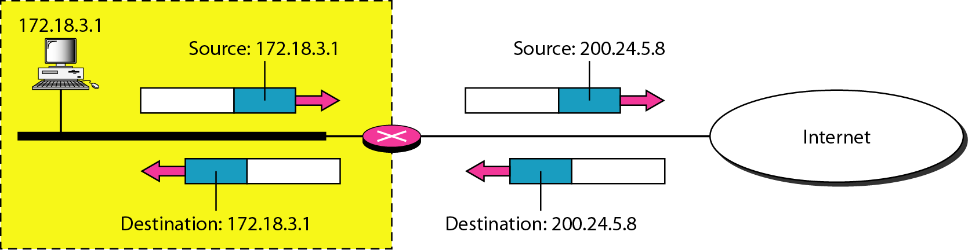
Figure 19.11 Addresses in a NAT
19.‹#›
Notes:
‹#›

Slide 30
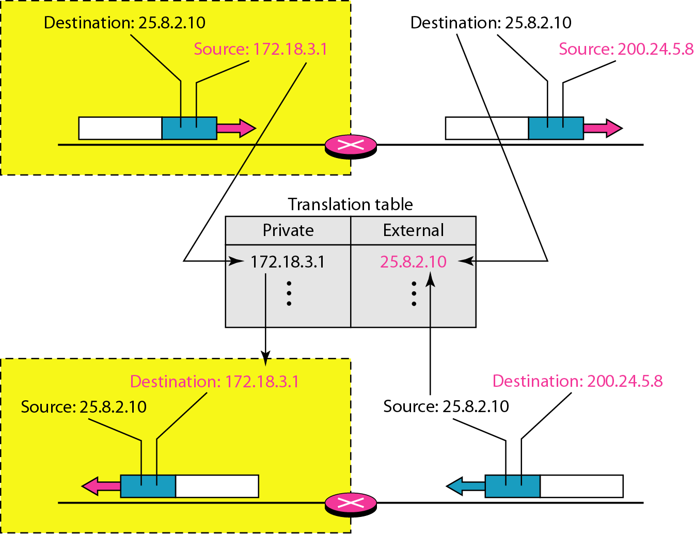
Figure 19.12 NAT address translation
19.‹#›
Notes:
‹#›

Slide 31
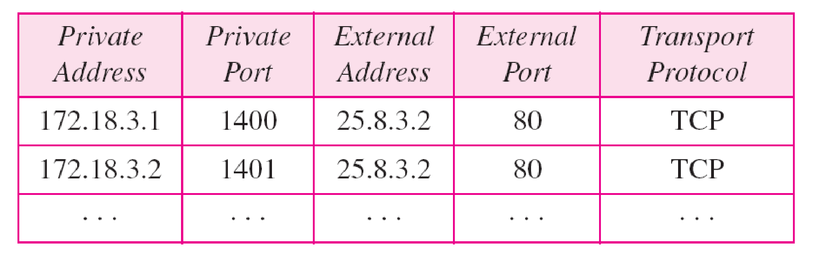
Table 19.4 Five-column translation table
19.‹#›
Notes:
‹#›

Slide 32
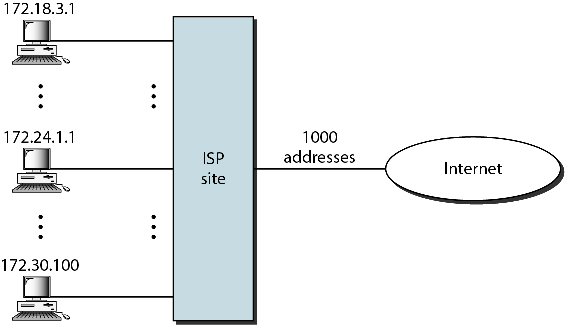
Figure 19.13 An ISP and NAT
19.‹#›
Notes:
‹#›

